Slide 1
Dried-plasma reconstitution experiment: phase III results
Coren Lahav
05 12th 2024

Slide 2
Agenda
Inspect VAMS sample QC results
Evaluate results with respect to predefined success criteria
Correlation between eluates and plasma samples
Response prediction accuracy
Repeatability of PROphet® class prediction
Will these results be adequate to convince insurance companies to cover a VAMS-based test?
Itamar recommended that we demonstrate non-inferiority of VAMS-plasma to plasma-plasma.
We show that VAMS-plasma agreement is inferior to plasma-plasma agreement.
We generated a VAMS filter and show that a new model based on this filter is non-inferior to the plasma-based PROphet model:
VAMS-plasma agreeing predictions within range of PROphet plasma-plasma repeatability
Preserved clinical validity and clinical utility
Conclusions and next steps

Slide 3
Three sample pairs seem to have been assayed twice
Type | PlateRunDate | SampleIdOH | ExtIdentifier | PlateId
Plasma | 27/07/2023 | 001-1022-0 | EXID40000009221598 | OH2023_021_set001
Plasma | 03/04/2024 | 001-1022-0 | EXID40000010432294 | OH2024_014
VAMS | 03/04/2024 | 001-1022-0 VAMS | EXID40000010432900 | OH2024_014
VAMS | 27/07/2023 | 001-1022-SL | EXID40000009221909 | OH2023_021_set001
Plasma | 27/07/2023 | 003-1300-0 | EXID40000009221907 | OH2023_021_set001
Plasma | 03/04/2024 | 003-1300-0 | EXID40000010432851 | OH2024_014
VAMS | 03/04/2024 | 003-1300-0 VAMS | EXID40000010432875 | OH2024_014
VAMS | 27/07/2023 | 003-1300-SL | EXID40000009221593 | OH2023_021_set001
Plasma | 27/07/2023 | 013-1808-0 | EXID40000009221906 | OH2023_021_set001
Plasma | 03/04/2024 | 013-1808-0 | EXID40000010432265 | OH2024_014
VAMS | 03/04/2024 | 013-1808-0 VAMS | EXID40000010432883 | OH2024_014
VAMS | 27/07/2023 | 013-1808-SL | EXID40000009221916 | OH2023_021_set001

Slide 4
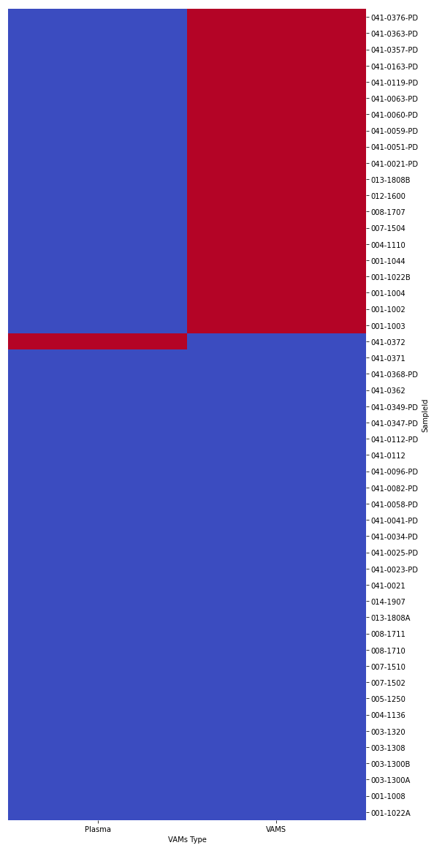
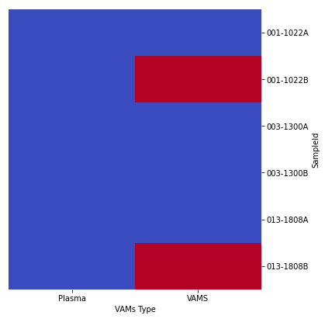
Plasma samples eluted from VAMS are often flagged
All samples
 | PASS | FLAG
Plasma | 49 | 1
VAMS | 30 | 20
Repeating samples
Pass
Flag
VAMS flagging does not seem
to be a strong property of the sample
Plasma
VAMS

Slide 5
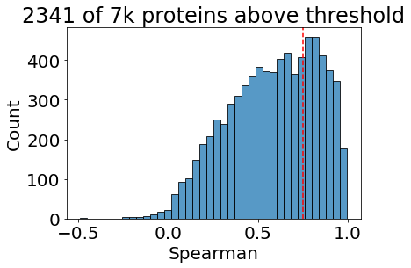
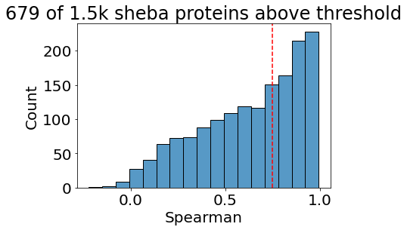
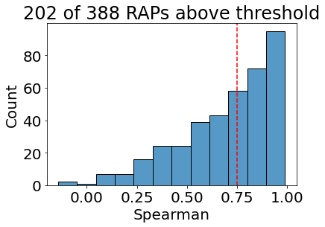
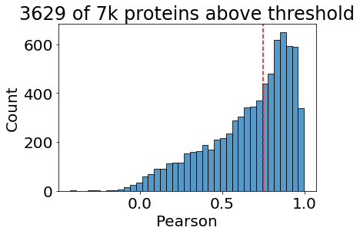
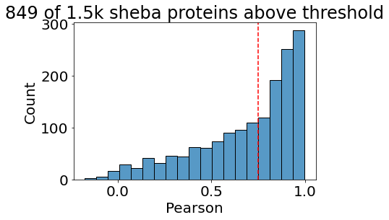
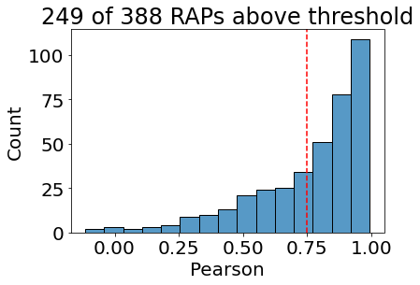
Correlation between eluates and plasma samples
Spearman’s r
Pearson’s r
Measure | Acceptance Criteria | Result
1. Correlation between eluates and plasma samples | 600 proteins with a Spearman correlation coefficient >0.75 and Pearson correlation coefficient >0.75 | 2225 proteins out of 7596 display both Spearman’s r > 0.75 and Pearson’s r > 0.75
646 of 1578 Sheba filter proteins, 195 of 388 RAPs pass criterion

Slide 6
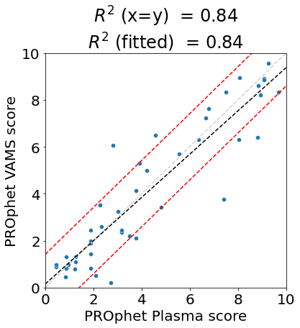
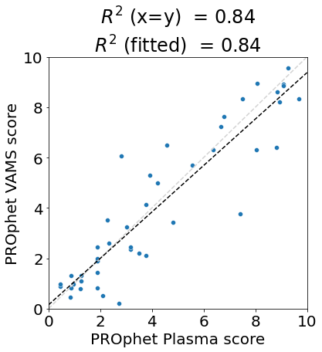

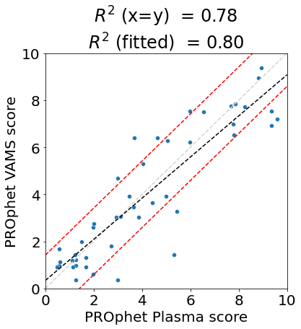
Plasma-VAMS sample pair correlation (n=45)
PROphetNSCLC v2.0
production model
PROphetNSCLC model
without sex
x = y
Best fit line
Predefined range
 | Plasma PROphet result
VAMS bridged PROphet result | Positive | Negative
Positive | 14 | 3
Negative | 2 | 26
 | Plasma PROphet result
VAMS bridged PROphet result | Positive | Negative
Positive | 14 | 4
Negative | 1 | 26
Measure | Description | Acceptance Criteria | Result
2. Response prediction accuracy | Response probability score (%) difference = | P_{Eluate} – P_{Plasma} | | | P_{Eluate} – P_{Plasma} | ≤10 for 75% of the samples | Agreement: 37 of 45 values (82.2%) with sex, 35 of 45 values (77.8%) without sex
3. Repeatability of PROphet® class prediction | The fraction of PROphetic patients that preserves their predicted PROphet class (POSITIVE / NEGATIVE). | 80% | Agreement: 88.9% with sex, 88.9% without sex
None-repeating patients sample pairs (n=45)

Slide 7
Raw model results passes all predefined criteria
Measure | Description | Acceptance Criteria | Result
1. Correlation between eluates and plasma samples | A scatter plot with RFU from plasma on the x-axis and RFU from eluates on the y-axis, for each analyte in all samples of the test cohort. | 600 proteins with a Spearman correlation coefficient >0.75 and Pearson correlation coefficient >0.75 | 2225 proteins out of 7596 display Spearman’s r > 0.75 and Pearson’s r > 0.75
2. Response prediction accuracy | Response probability score (%) difference = | P_{Eluate} – P_{Plasma} | | | P_{Eluate} – P_{Plasma} | ≤10 for 75% of the samples | Agreement: 37 of 45 values (82.2%) with sex, 35 of 45 values (77.8%) without sex
3. Repeatability of PROphet® class prediction | The fraction of PROphetic patients that preserves their predicted PROphet class (POSITIVE / NEGATIVE). | 80% | Agreement: 88.9% with sex, 88.9% without sex

Slide 8
Will these results be enough to replace plasma measurements with VAMS?
Probably not.
To convince insurance companies that VAMS is adequate for our test, it would be of high value to show VAMS non-inferiority to plasma.
We proceed by showing that:
VAMS-plasma measurement agreement is inferior to plasma-plasma.
VAMS-plasma prediction agreement is inferior to plasma-plasma.
The model can be adapted by adding a VAMS filter on top of the Sheba filter. A model based on this filter will only include VAMS-plasma agreeing proteins.
Such models yield results that agree between VAMS and plasma (non-inferior to plasma-plasma)
Such models retains clinical validity and clinical utility of the original PROphet model.

Slide 9
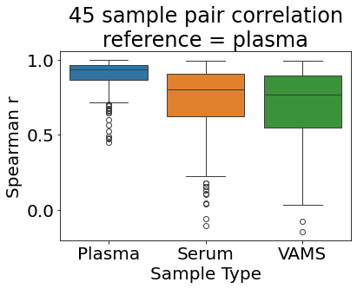
Sample matrix pairing correlation
*
As expected, plasma-plasma pairing is superior to plasma vs other matrices.
Plasma-VAMS pairing is inferior to plasma-serum pairing.
*Disclaimer: Plasma-VAMS agreement measured within plate BUT other pairings measured between plates

Slide 10
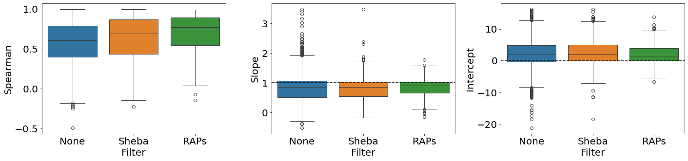
Plasma-VAMS protein correlations and linear correction coefficients
None-repeating patients sample pairs (n=45)

Slide 11
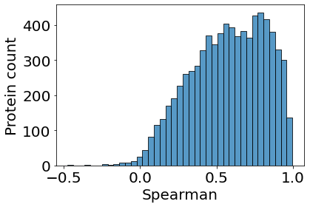
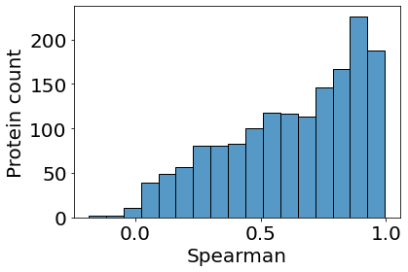
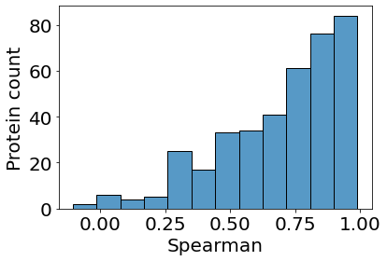
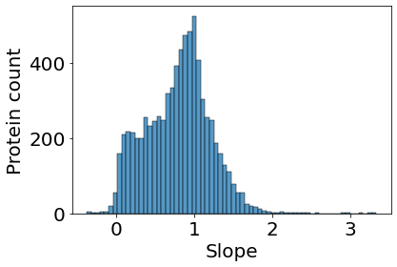
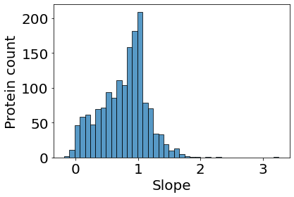
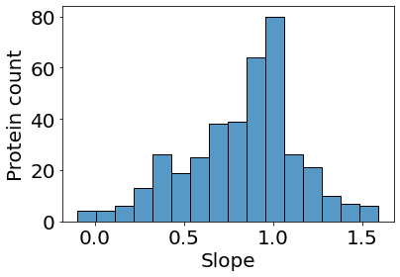
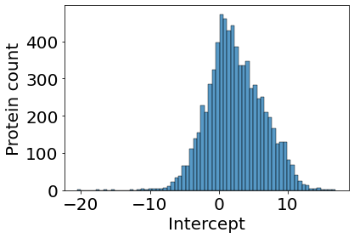
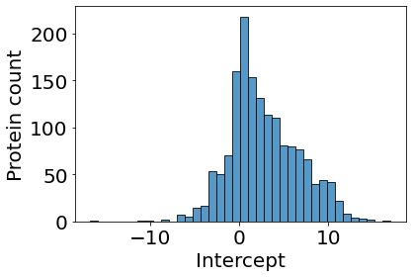
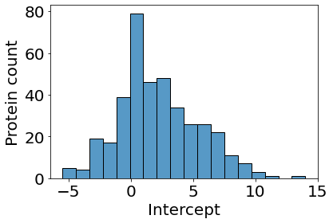
Plasma-VAMS correlations and linear correction coefficients
7k proteins
1.5k Sheba filter
388 RAPs
Spearman
correlation
Slope
Linear correction factor
Intercept
None-repeating patients sample pairs (n=45)

Slide 12
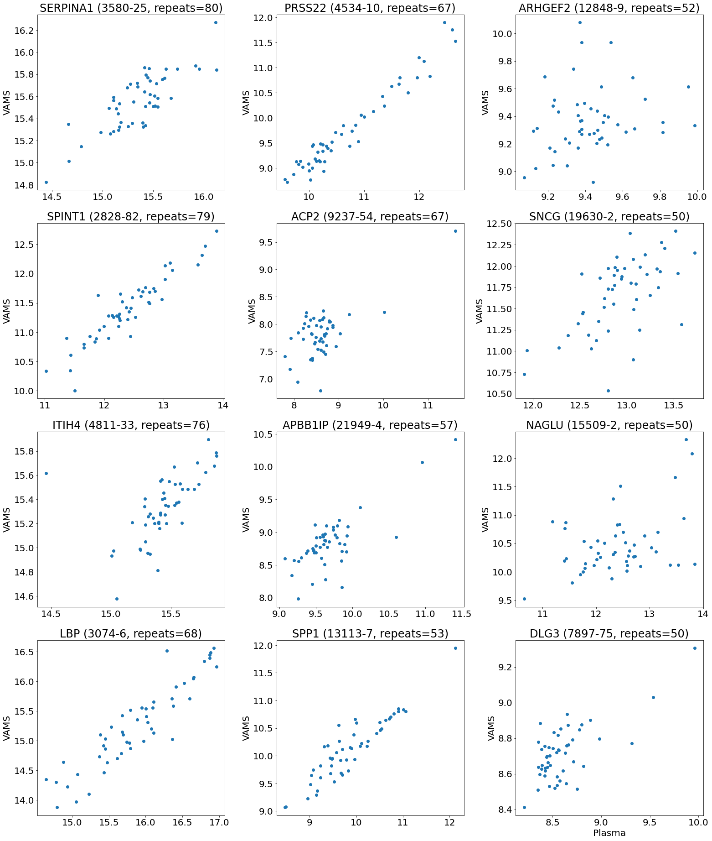
Top 12 RAPs: Plasma-VAMS scatterplots (raw measurement values)
None-repeating patients sample pairs (n=45)

Slide 13
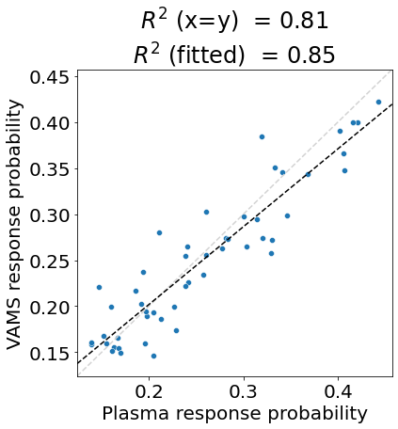
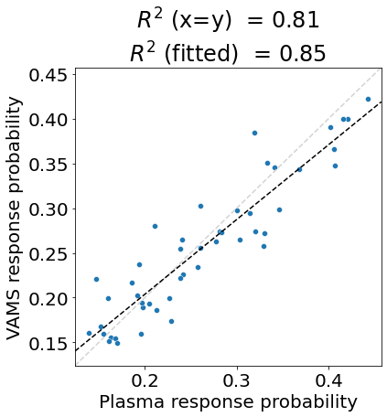
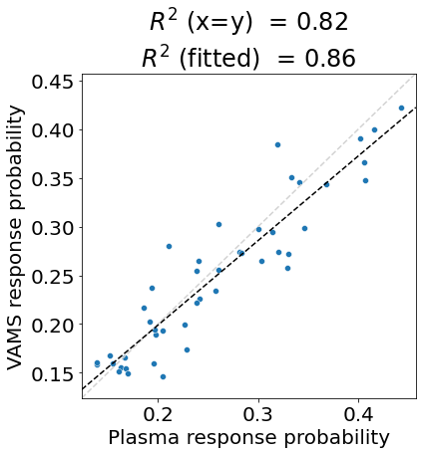
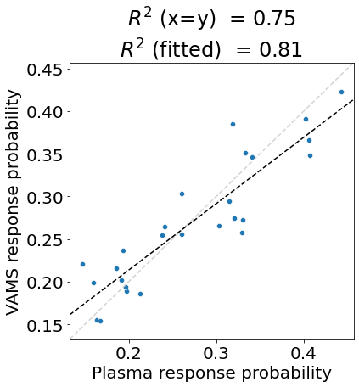
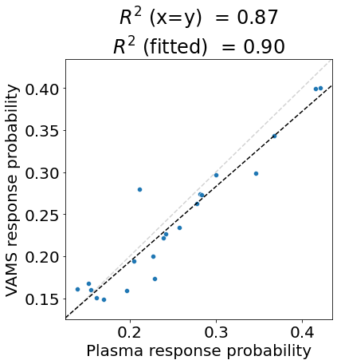
Plasma-VAMS sample pair correlation PROphet NSCLC v2.0 model
None-repeating
sample pairs (n=47)
None-repeating patients
sample pairs (n=45)
All sample pairs (n=50)
T0 sample pairs (n=26)
TPD sample pairs (n=21)
 | Plasma PROphet result
VAMS bridged PROphet result | Positive | Negative
Positive | 14 | 2
Negative | 6 | 28
 | Plasma PROphet result
VAMS bridged PROphet result | Positive | Negative
Positive | 14 | 2
Negative | 6 | 25
 | Plasma PROphet result
VAMS bridged PROphet result | Positive | Negative
Positive | 13 | 2
Negative | 5 | 25
 | Plasma PROphet result
VAMS bridged PROphet result | Positive | Negative
Positive | 9 | 1
Negative | 3 | 13
 | Plasma PROphet result
VAMS bridged PROphet result | Positive | Negative
Positive | 5 | 1
Negative | 3 | 12

Slide 14
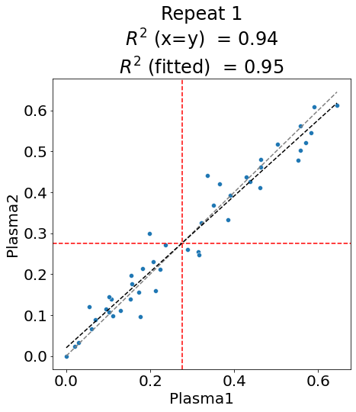
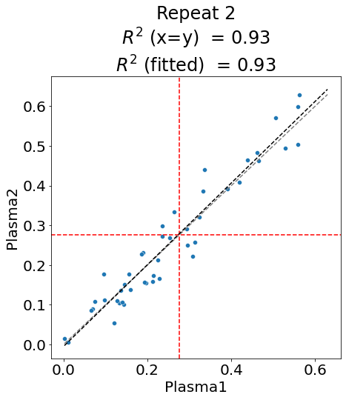
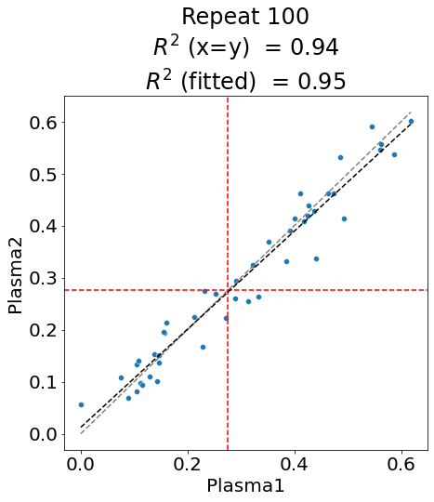
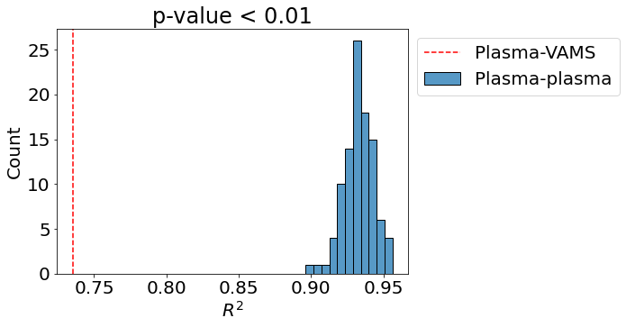
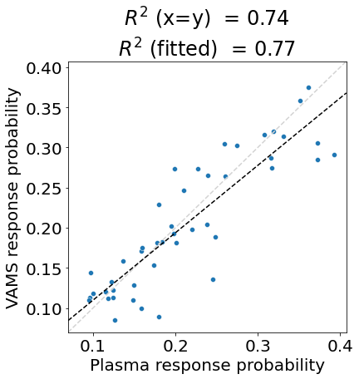
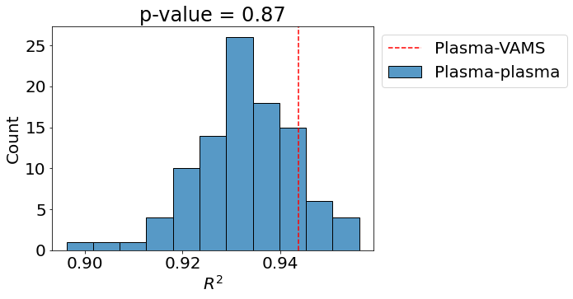
Plasma-VAMS prediction agreement is inferior to plasma-plasma agreement
(A)
 | Plasma 1 PROphet result
Plasma 2 PROphet result | Positive | Negative
Positive | 17.64 ± 1.93 | 2.85 ± 1.39
Negative | 2.6 ± 1.20 | 23 ± 2.1
Plasma-plasma
(100 repeats)
…
(B)
(C)
 | Plasma PROphet result
VAMS bridged PROphet result | Positive | Negative
Positive | 14 | 3
Negative | 2 | 26
Plasma-VAMS
experiment result
Using the PROphet model as is on VAMS samples yields inferior agreement to plasma-plasma

Slide 15
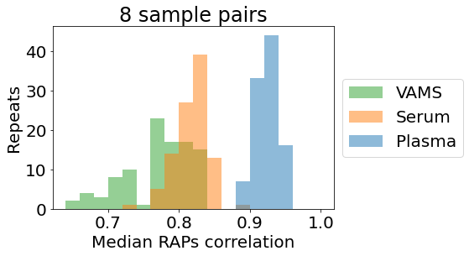
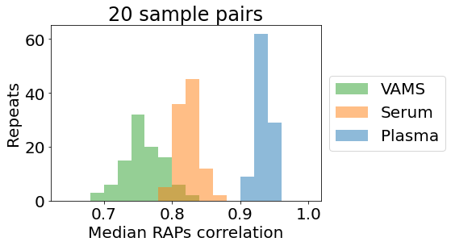
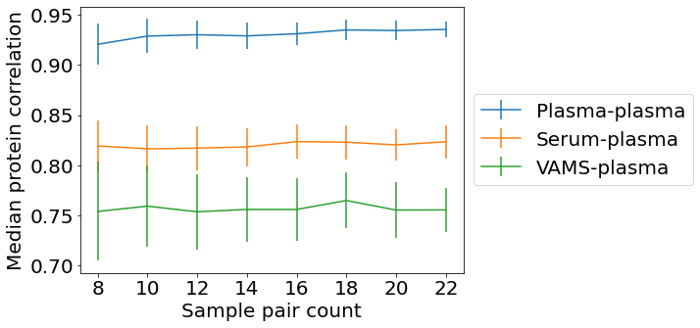
Plasma-plasma vs plasma-serum vs plasma-VAMS protein correlations
Repeat 100 times:
Sample n pairs
Calculate spearman correlation per RAP
Find median RAP correlation
Only RAPs included
Conclusions
Increasing number of sample pairs does not affect average correlation
As expected, plasma-plasma pairs display higher correlations than plasma vs other matrices.
Serum-plasma pairing is superior to VAMS-plasma
None-repeating patients sample pairs (plasma-plasma 351 samples from 23 patients all measured in OncoHost lab starting 2023; serum-plasma n=43; VAMS-plasma n=45)

Slide 16
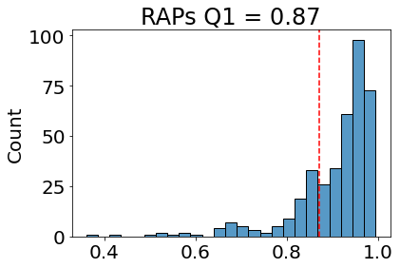
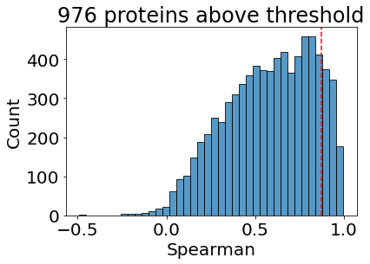

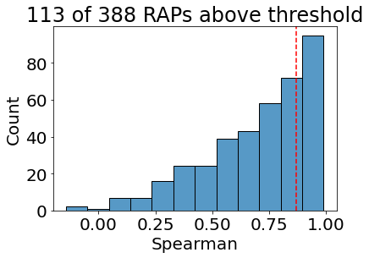
Plasma-plasma vs plasma-serum vs plasma-VAMS protein correlations
Threshold defined based on plasma-plasma RAPs
Only RAPs included
Threshold used to filter proteins based on plasma-VAMs correlation
When taking weight
(repeats) into account
1,516 of 4,000
Non-repeating patients sample pairs (plasma-plasma 351 samples from 23 patients; serum-plasma n=43; VAMS-plasma n=45)

Slide 17
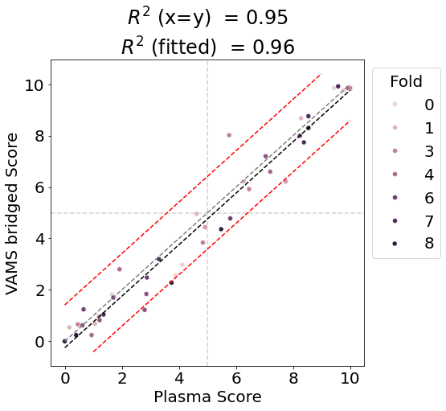
Plasma-VAMS sample pair correlation (n=45)
PROphetNSCLC v3.0
retrained in cross-validation on VAMS filter proteins
500 PROphet patients
45 paired plasma-VAMS
samples
Sets:
500 PROphetNSCLC patients used in Dana Farber model training
45 paired plasma-VAMS samples
9-fold cross validation: 40 fit samples, 5 evaluation samples
Procedure:
For each plasma-VAMS fold:
Calculate plasma-VAMS fit set correlation per protein
Select ~400 candidate proteins that pass both Sheba and VAMS filter
Train RAP model using 500 patient cohort using only the ~400 proteins
Fit bridging factors on fold train set
Run cross-validation predictions for plasma and VAMS for this fold evaluation samples
Evaluate cross-validation prediction agreement
 | Plasma PROphet result
VAMS bridged PROphet result | Positive | Negative
Positive | 17 | 0
Negative | 2 | 26
Measure | Description | Acceptance Criteria | Result
2. Response prediction accuracy | Response probability score (%) difference = | P_{Eluate} – P_{Plasma} | | | P_{Eluate} – P_{Plasma} | ≤10 for 75% of the samples | Agreement: 41 of 45 values (91.1%)
3. Repeatability of PROphet® class prediction | The fraction of PROphetic patients that preserves their predicted PROphet class (POSITIVE / NEGATIVE). | 80% | Agreement: 95.6%
None-repeating patients sample pairs (n=45)

Slide 18
VAMS filtered model results passes all predefined criteria with a margin
Measure | Description | Acceptance Criteria | Result
1. Correlation between eluates and plasma samples | A scatter plot with RFU from plasma on the x-axis and RFU from eluates on the y-axis, for each analyte in all samples of the test cohort. | 600 proteins with a Spearman correlation coefficient >0.75 and Pearson correlation coefficient >0.75 | 2225 proteins out of 7596 display Spearman’s r > 0.75 and Pearson’s r > 0.75
2. Response prediction accuracy | Response probability score (%) difference = | P_{Eluate} – P_{Plasma} | | | P_{Eluate} – P_{Plasma} | ≤10 for 75% of the samples | Agreement: 41 of 45 values (91.1%)
3. Repeatability of PROphet® class prediction | The fraction of PROphetic patients that preserves their predicted PROphet class (POSITIVE / NEGATIVE). | 80% | Agreement: 95.6%

Slide 19
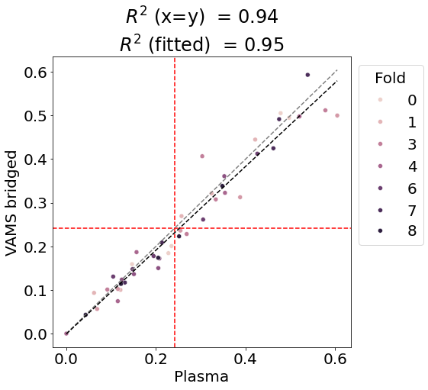
After adding the protein filter, Plasma-VAMS agreement is comparable to plasma-plasma agreement
(A)
 | Plasma 1 PROphet result
Plasma 2 PROphet result | Positive | Negative
Positive | 17.64 ± 1.93 | 2.85 ± 1.39
Negative | 2.6 ± 1.20 | 23 ± 2.1
Plasma-plasma
(100 repeats)
…
(B)
(C)
 | Plasma PROphet result
VAMS bridged PROphet result | Positive | Negative
Positive | 19 | 0
Negative | 3 | 23
Plasma-VAMS
experiment result
After adding the protein filter, Plasma-VAMS agreement is comparable to plasma-plasma agreement

Slide 20
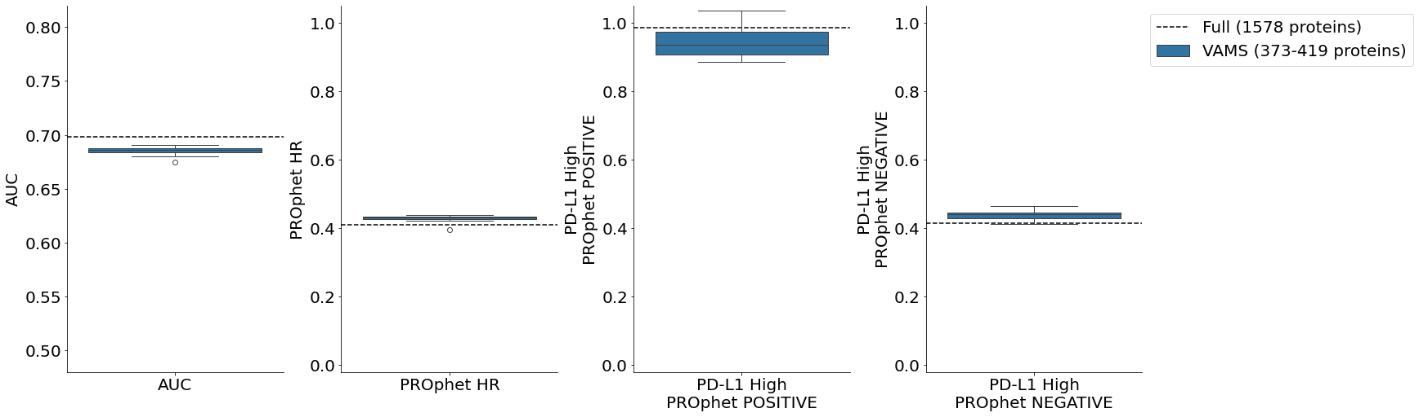
Effect of VAMS filter on clinical validity and clinical utility
Clinical validity
Clinical utility
Model | # proteins | AUC | PROphet HR | PD-L1 High PROphet POSITIVE | PD-L1 High PROphet NEGATIVE
DF model | 1578 | 0.698 | 0.409 | 0.985 | 0.414
Fold 0 | 398 | 0.686 | 0.435 | 0.990 | 0.413
Fold 1 | 383 | 0.686 | 0.422 | 0.936 | 0.445
Fold 2 | 391 | 0.690 | 0.429 | 0.969 | 0.429
Fold 3 | 419 | 0.685 | 0.427 | 0.906 | 0.440
Fold 4 | 373 | 0.684 | 0.434 | 0.885 | 0.465
Fold 5 | 386 | 0.680 | 0.439 | 1.035 | 0.419
Fold 6 | 401 | 0.688 | 0.431 | 0.973 | 0.445
Fold 7 | 415 | 0.690 | 0.432 | 0.905 | 0.448
Fold 8 | 409 | 0.674 | 0.396 | 0.931 | 0.434
all p-values < 0.0001
all p-values < 0.0001
all p-values > 0.70
all p-values < 0.05
Conclusions:
Addition of the VAMS filter (1578 → ~400 proteins) only slightly affects model performance.
Clinical validity and clinical utility are preserved.

Slide 21
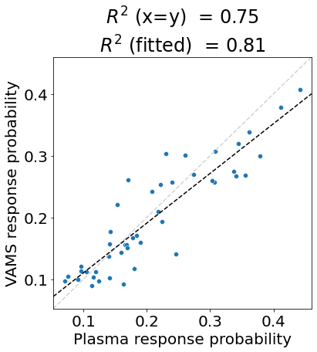
Plasma-VAMS sample pair correlation (n=45)
PROphetNSCLC v2.0
production model
PROphetNSCLC model
without sex
PROphetNSCLC v3.0
retrained in cross-validation on VAMS filter proteins
 | Plasma PROphet result
VAMS bridged PROphet result | Positive | Negative
Positive | 13 | 2
Negative | 5 | 25
 | Plasma PROphet result
VAMS bridged PROphet result | Positive | Negative
Positive | 14 | 4
Negative | 1 | 26
 | Plasma PROphet result
VAMS bridged PROphet result | Positive | Negative
Positive | 19 | 0
Negative | 3 | 23
Note: threshold was based on a single fold. Threshold selection is overfitted.
None-repeating patients sample pairs (n=45)

Slide 22
Conclusions
40% of VAMS samples are flagged by the current QC procedure. VAMS sample QC (flagging) will have to be redefined for VAMS samples.
VAMS-plasma agreement passed all predefined criteria
After adding a VAMS filter to the Sheba filter (1578 → ~400 proteins):
VAMS models achieve agreement with plasma that is non-inferior to plasma-plasma pairing*
VAMS models preserve clinical validity and clinical utility
* Disclaimers:
Plasma-VAMS agreement measured within plate BUT
Plasma-plasma agreement measured between plate

Slide 23
Next steps
VAMS on fresh plasma
VAMS on whole blood?

Slide 24
Thank you!

